Slide 1
NLP Assignment Presentation Title : Fake SMS Classification Programme: Bachelor of Technology in AIML
Course Leader : Mr. Nivedan Yakolli
Team Members : PRATISTHA GAUR, PRRATHYUSH KEDEELAYA
Department : Computer Science and
Engineering

Slide 2
Assignment Team
Sl no. | Registration no. | Student Names
1 | 20ETAI410035 | PRATISTHA GAUR
2 | 20ETAI410036 | PRRATHYUSH KEDEELAYA

Slide 3
Outline
Introduction
Title and Aim
Literature summary
Objectives and Motivation
Dataset Selection
NLP Pre-processing Steps
Implementation Challenges and Solutions
Demonstration and Conclusion
References

Slide 4
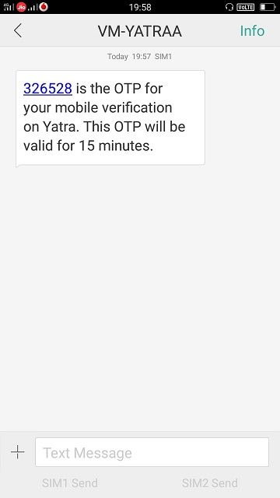
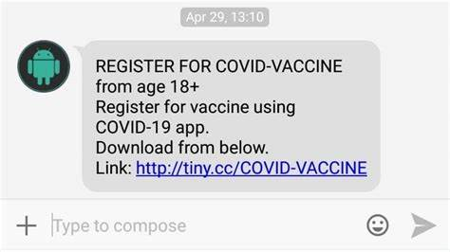
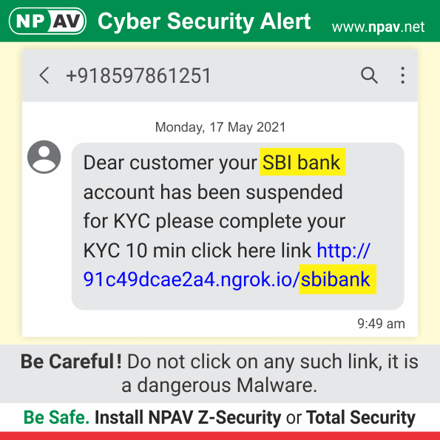
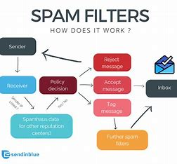
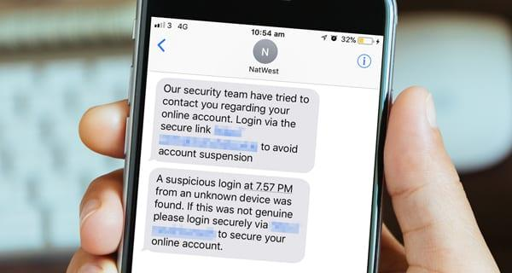
Introduction
Fake SMS classification is the task of identifying text messages that are intentionally misleading, fraudulent, or deceptive. These messages are often sent with the intent to trick the recipient into disclosing personal
information or taking some other action that benefits the sender.
Fake SMS detection models have a range of applications, including:
Spam filtering
Security
3. Fraud detection
4. Customer service
5. Social media

Slide 5
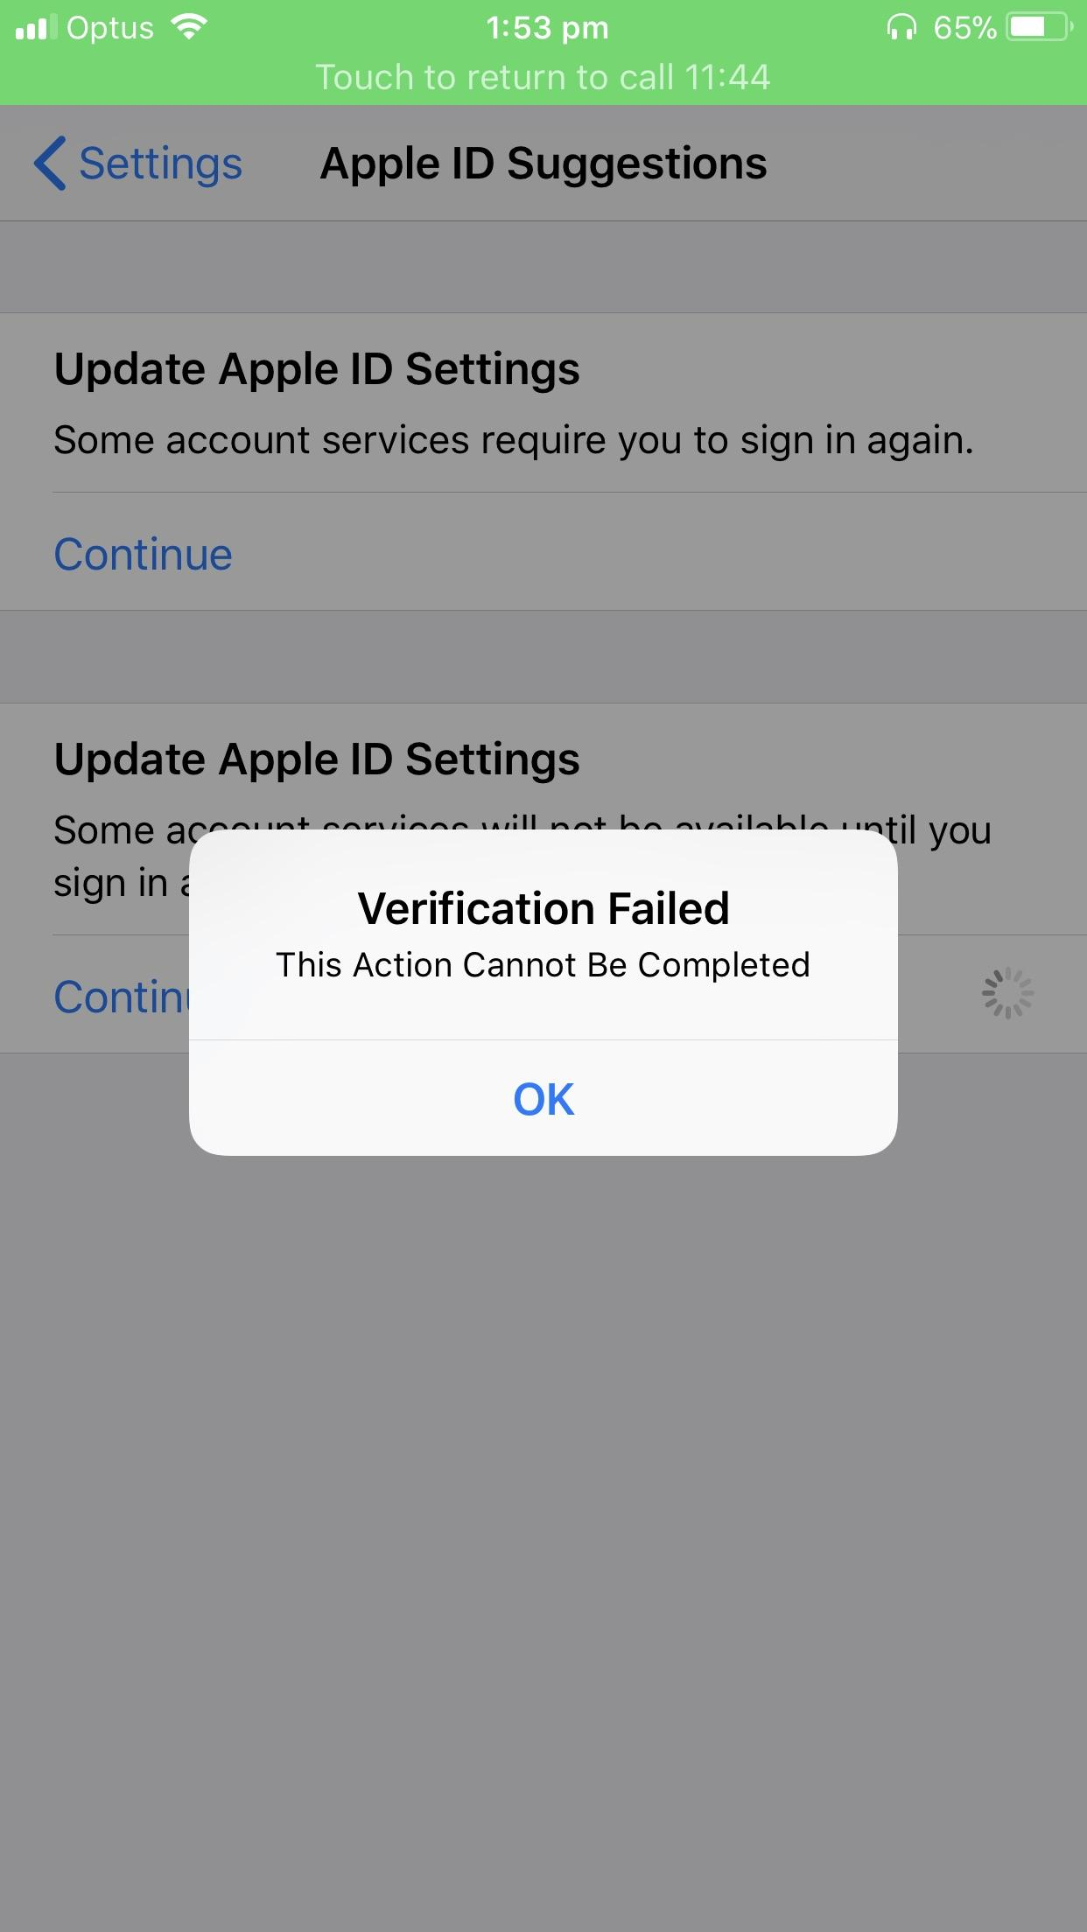

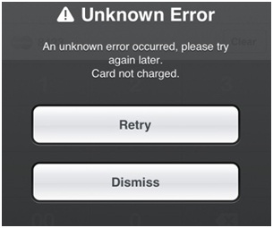
Title and Aim
Title: Fake SMS Classification
Aim: Develop a machine learning model that can accurately classify SMS messages as either spam or legitimate. The goal is to build a model that can effectively identify spam messages and prevent them from reaching users' inboxes, while also minimizing the number of legitimate messages that are incorrectly classified as spam. This project is a practical application of natural language processing and machine learning techniques for text classification.

Slide 6
Literature Summary
Sno. | Authors | Year of Publication | Research Focus | Methods and Methodologies used | Research Findings | Conclusions drawn by authors | Limitations of Study
01 | Pratistha Gaur | 2023 | On developing a machine learning-based spam SMS classification system using natural language processing techniques | The methodology involved several steps data preprocessing, exploratory data analysis, feature engineering, model building, and evaluation.. | The preprocessing steps, such as converting text to lowercase, removing stop words, and lemmatizing the text, significantly improved the model's performance. The random forest classifier was found to be an effective model for spam SMS classification, outperforming other models such as Logistic Regression and Support Vector Machines. | The use of the TF-IDF feature extraction technique and oversampling method for handling imbalanced data was also effective in improving the performance of the model. The random forest classifier was found to be an effective model for spam SMS classification. | The approach relies heavily on the quality of the text preprocessing steps, such as removing stop words, lemmatization, and tokenization. If these steps are not performed correctly, the model's performance may suffer.
02 | Prrathyush Kedeelaya | 2023 | The project aims to address the challenges associated with detecting spam SMS messages, such as handling class imbalance, preprocessing text data, and creating effective machine learning models. | Along with handling imbalanced datasets, cross-validation, and hyperparameter tuning techniques. | The TF-IDF feature extraction technique was effective in converting text data into numerical vectors that can be used as input to a machine learning model. Handling imbalanced datasets using oversampling technique was shown to be an effective method for improving the performance of the model on the minority class. | This project successfully developed a spam SMS classification system using machine learning-based approaches and natural language processing techniques. The system achieved high accuracy in detecting spam SMS messages, and the preprocessing steps significantly improved the model's performance | The approach does not take into account the context and intent of the SMS message, which can sometimes be crucial in determining whether a message is a spam or not. For example, a message that contains the word "free" may not necessarily be spam if it is a legitimate promotion from a company.

Slide 7
Objectives and Motivation
The objectives :
To develop a spam SMS classifier using natural language processing and machine learning techniques.
To compare the performance of different classification algorithms, including Multinomial Naive Bayes, Decision Trees, Random Forest, and Ensemble methods.
To evaluate the effectiveness of different feature engineering techniques, including TF-IDF and Bag-of-Words.
To handle the issue of class imbalance in the dataset using oversampling techniques.
To provide a practical solution for spam detection in SMS messages.
The motivation for this project is the increasing prevalence of spam messages, which can be potentially harmful to users. By developing an accurate and effective spam SMS classifier, we can help users filter out unwanted messages and improve the overall user experience.

Slide 8
Dataset Selection
The dataset contains 5,574 SMS messages that are labeled as either spam or ham (non-spam).
The messages were collected from various sources, including mobile phones and online message boards. The dataset was collected in 2012 and has been used in many research studies on spam SMS classification.
Each message in the dataset is represented as a single line of text.
The text includes a combination of words, numbers, and symbols.
Here is an example1 of a message from the dataset:
"URGENT! You have won a 1 week FREE membership in our $100,000 Prize Jackpot! Txt the word: CLAIM to No: 81010 T&Cs www.idew.com 1 winweekly age16. unsubscribe@idew.co.uk“
The label for each message is included in a separate column in the dataset. The label is either "spam" or "ham’’.
Here is an example of a labeled message from the dataset:
"ham", "I'm at work. Please call“
In addition to the raw text and label, the dataset includes a unique ID for each message. The IDs range from 0 to 5,573 and are used to identify individual messages in the dataset.

Slide 9
Sample data
Type | Text
spam | FreeMsg: Txt: CALL to No: 86888 & claim your reward of 3 hours talk time to use from your phone now! Subscribe6GB
legitimate | I'll be late, don't wait for me
legitimate | Sorry, I can't take your call right now.
spam | FreeMsg: Ringtone!From: http://tms. widelive.com/index. wml?id=1b6a5ecef91ff9&first=trueCall 08712402779. Uk only£1.50 per tone
legitimate | We have sent a file to your email. Please check.
legitimate | Please call our customer service representative on 0800 169 6031 between 10am-9pm as you have WON a guaranteed £1000 cash or £5000 prize!

Slide 10
NLP Pre-processing Steps
Preprocessing steps for fake SMS detection may include the following:
Text cleaning
Tokenization
Stopword removal
Lemmatization or stemming
Part-of-speech tagging:
Named entity recognition
Feature extraction
The preprocessing steps can be performed using various natural language processing techniques and libraries, such as NLTK, spaCy, and scikit-learn.

Slide 11
Implementation Challenges and Solutions
Data imbalance: The dataset had a high imbalance between the number of spam and legitimate messages, which can lead to biased models that perform poorly on the minority class. To overcome this, we had to use oversampling techniques to create synthetic samples of the minority class.
Text pre-processing: SMS messages are often unstructured and contain non-standard abbreviations, slang words, and misspellings. This makes it challenging to pre-process the text and extract meaningful features. We had to use several pre-processing techniques, such as tokenization, removing stop words, and stemming, to clean and normalize the text.
Model selection: Many machine learning algorithms can be used for text classification, and selecting the best one for our specific task required experimentation and evaluation of several models.
Evaluation metrics: Accuracy alone is not a sufficient metric for evaluating the performance of classification models, especially for imbalanced datasets. We had to consider other metrics such as precision, recall, and F1-score to evaluate the models' performance.
Overall, these challenges required careful consideration and experimentation to overcome and improve the performance of the fake SMS detection models.

Slide 12
Demonstration and Conclusion
The fake SMS detection project using machine learning algorithms and techniques, such as pre-processing, feature engineering, and classification, has been successful in accurately identifying and classifying spam and legitimate SMS messages.
Through the use of the "Spam SMS Collection" dataset, we were able to train and test several models, including Multinomial Naive Bayes, Decision Trees, Random Forest, and Ensemble models, to achieve high accuracy in detecting spam messages.
Handling the imbalanced dataset through oversampling techniques, such as SMOTE, was also successful in improving the performance of our models.
Overall, this project has demonstrated the effectiveness of machine learning in detecting and filtering out unwanted SMS messages, which has a range of potential applications in areas such as spam filtering, fraud detection, and customer service.

Slide 13
References
References:
Natural Language Processing with Python by Steven Bird, Ewan Klein, and Edward Loper
Scikit-learn documentation: https://scikit-learn.org/stable/documentation.html
NLTK documentation: https://www.nltk.org/
Pandas documentation: https://pandas.pydata.org/docs/
Matplotlib documentation: https://matplotlib.org/
Seaborn documentation: https://seaborn.pydata.org/
Towards Data Science: https://towardsdatascience.com/
Kaggle: https://www.kaggle.com/
GitHub: https://github.com/
The specific dataset used in this project can be found here:
https://www.kaggle.com/uciml/sms-spam-collection-dataset.

Slide 14
Thank You

